Slide 1
CrossFS: A Cross-layered Direct-Access File System
Yujie Ren, Rutgers Univ. Changwoo Min, Virginia Tech, Sudarsun Kannan Rutgers Univ.
In 2020 USENIX Symposium on Operating Systems Design and Implementation
2021. 02. 02
Presentation by Inho, Song
inhoinno@dankook.ac.kr

Slide 2
Background & Introduction
Motivation
Evaluation(1/2)
Design
Evaluation(2/2)
Conclusion
Notes:
This is the outline on my talk.
First, I will describe garbage Collection overhead in SSDs and Multi-Streamed SSD
Then, the details of PCStream design and analysis results are presented.
Finally, I will conclude my talk.

Slide 3


1. Background & Introduction
Three Main Bottleneck
Thread A
Thread B
write(shared_file, Block 2)
write(shared_file, Block N)
1.
High Software overheads
(system call for performing I/O, 1-4μs)
2.
Non-scalable concurrent access
when accessing disjoint block
(e.g. inode-level rw lock)
inode
4k
…
Shared file
Block 1
Block N
General File System
Notes:
이 논문에서 말하는 Concurrency 성능에서 3가지 Main Bottle neck이 있습니다
먼저 그림은 2개의 쓰레드가 한 개의 공유파일에 접근하려고 하는데, 이때 서로 다른 블록에 접근하려고 합니다.
System Call 을 먼저 호출합니다, Trap이 걸리게 되고,
서로 다른 블록임에도 불구하고, 아이노드 레벨에서 락이 잡히게 되고,

Slide 4
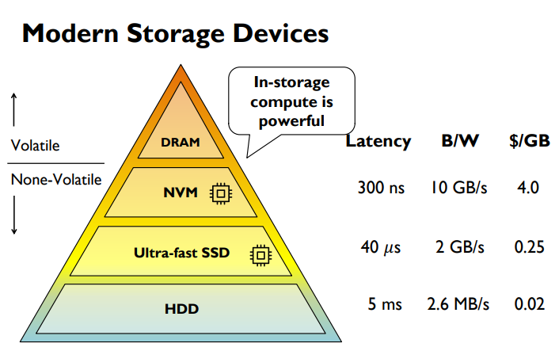
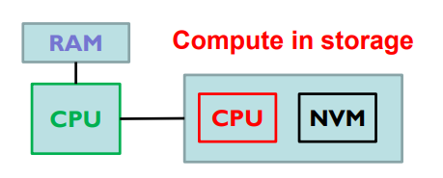
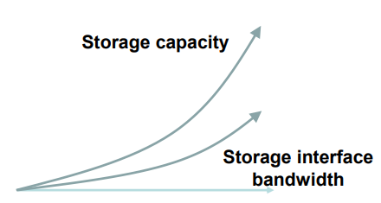
1. Background & Introduction
Trend of Modern Storage Devices
In storage computing, The choice of implementation today*
3.
Lack support for leveraging host and device-level compute
(Host CPU are fast, but low utilization for processing I/O request )
*A Comparison of In-Storage Processing Architectures and Technologies, Jérôme Gaysse, 2018 SDC
Notes:
2개의 Main BottleNeck 이 있었는데, 마지막 하나는 하드웨어적인 관점입니다
최근 스토리지 디바이스에 SSD말고도 NVM을 사용하는 경우가 많아졌고, 성능도 빵빵한데
소프트웨어가 그것을 적절히 활용하지 못하고 있다는 주장입니다
구체적으로, Lack support for leveraging host and device level compute 에서,. Device CPU와 HostCPU가 엄청난 차이가 있는데,
기존에 있는 FS들은 호스트CPU와 DeviceCPU간에 성능 분배를, Utilize를 하지 못한다는것이 마지막 Bottleneck 입니다.

Slide 5

2. Motivation
Poor concurrent access scalability
Applications must ‘trap’ into an OS
Inode-centric design limit
Lack of synergistic design : combined use of host and device resource
Ext4-DAX
Strata
DevFS
Notes:
NVM은 DRAM보다 용량이 크고 storage보다 속도가 빠르다. 영구적인 데이터를 접근할 때 메모리에 접근할 때처럼 byte단위로 접근이 가능하다 그래서 메모리와 스토리지 간의 페이지 블록 단위의 접근을 없앨 수 있다.

Slide 6
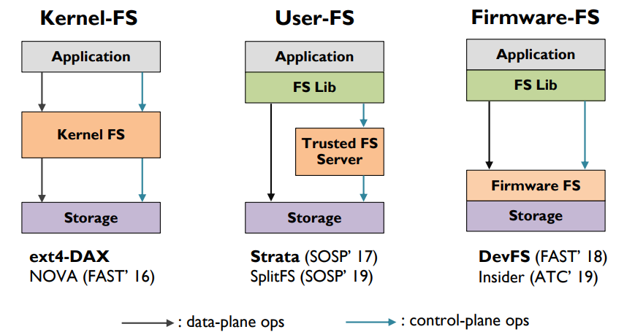
2. Motivation
Doesn’t exploit powerful host CPU at all
System call,trap …
Notes:
기존에 존재하는 KernelFS, UserFS, Firmware FS구조인데,
기본적으로 KernelFS는 Kernel을 통해서, Trap을 거쳐 스토리지로 내려갑니다. Direct Access는 안되고 있죠
UserFS의 경우, Application level에서 FS를 구현하는데, Data 에 관한 operations들은 Direct하게 가는데, Control 부분에서는 Application레벨이다 보니 OS, 혹은 Trusted FS Server 를 통해서 데이터 이외의 명령들은
신뢰성을 얻은 다음 Storage로 접근이 됩니다.
FirmwareFS의 경우, 아예 FS를 스토리지 레벨로 내려버린것인데요, 이때는 Storage 자원을 사용하게 된다는 단점이 있다고 Motivation 부분에서 저자가 언급했습니다.

Slide 7
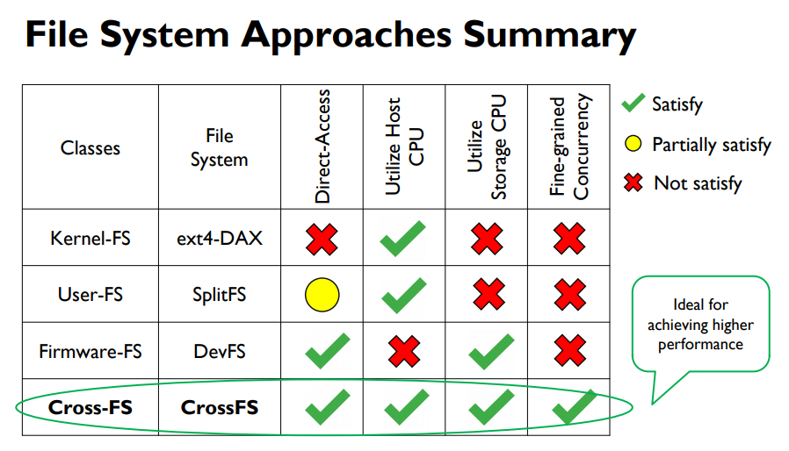
2. Motivation
Notes:
자 그래서 정리를 해보자면,

Slide 8
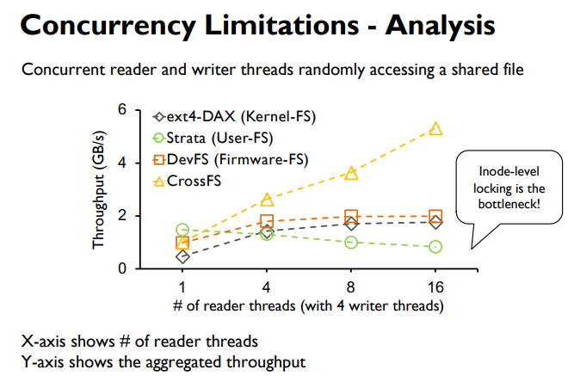
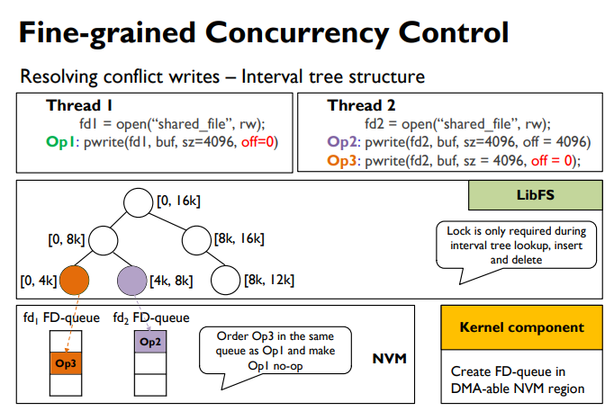
Designs a synergistic design across the user, the kernel, and the firmware layers
How much improvement?
How to design FS ?
Notes:
이쯤되면 이런 생각이 듭니다.
??? : “참 건방지네? 그래서 얼마나 좋아졌는데? 또 어떻게 설계를 했는데?”
라는 생각이 드는데요,
간단하게 얼마나 좋아졌고, 그뒤에 이사람들이 어떻게 설계했는지 알아보겠습니다.

Slide 9
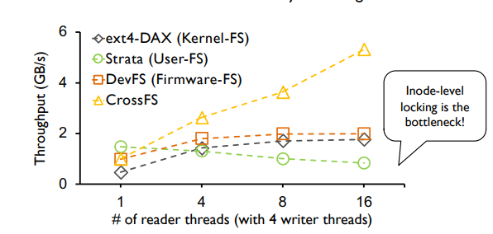
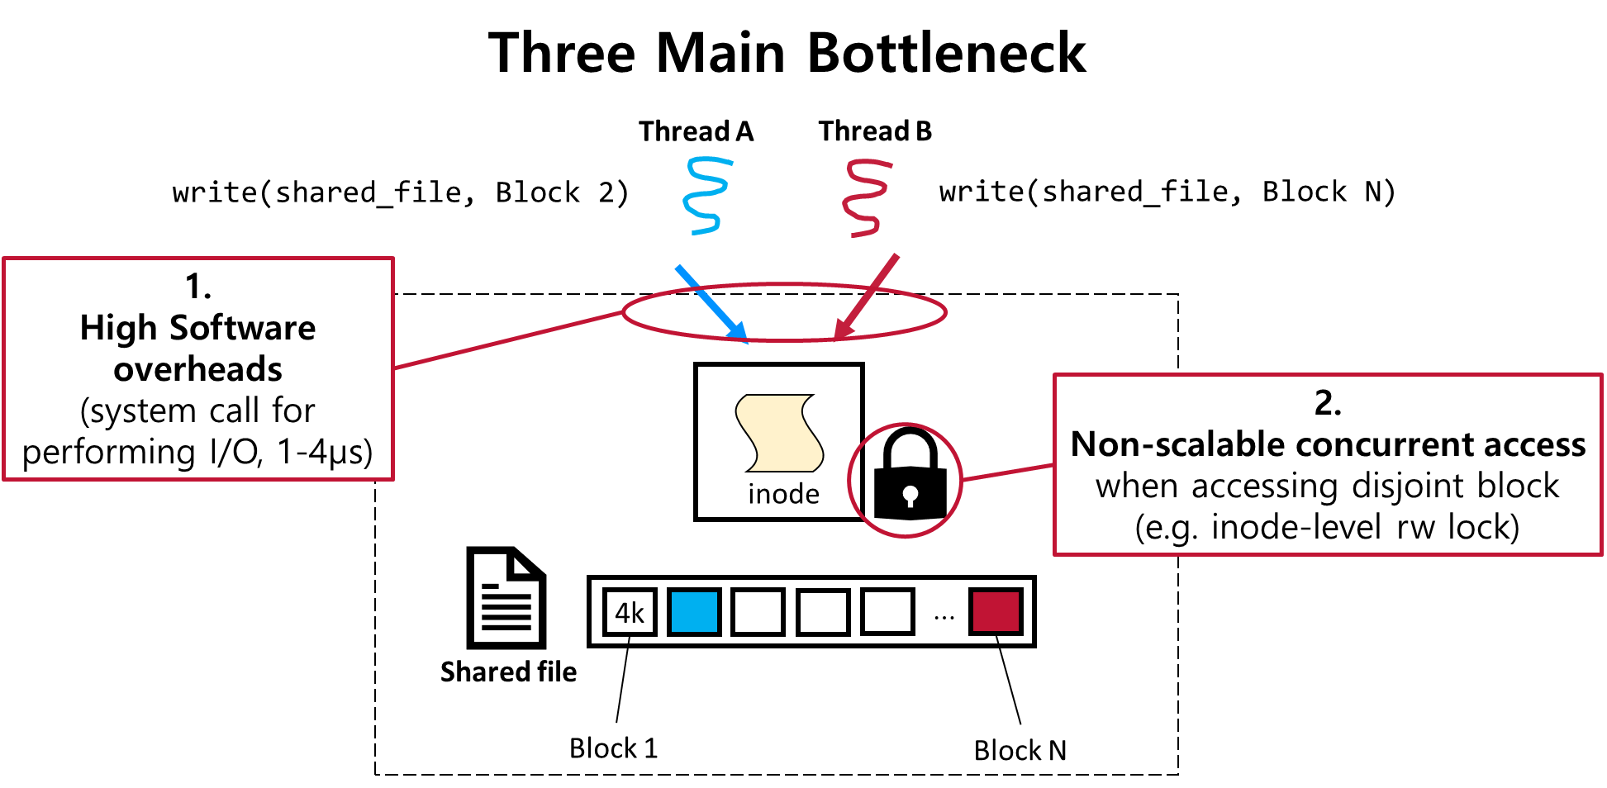
3. Evaluation (1/2)
Concurrent Read Throughput
Sharing across Reader and Writer Threads
Ext4-DAX, Strata, DevFS,
→ The read performance does not scale even when accessing disjoint blocks, mainly due to inode-level rw-lock
Aggregated read throughput when there are 4-concurrent writter
Notes:
먼저
CrossFS ioctl인데,
자신들이 말한 3메인 Bottleneck을 피하고, disjoint블록에 대해서 접근을 허용해주었더니
12GB파일에 대해서 4개의 writer가 존재할 때 Reader 의 읽기 througput을 살펴보았더니
혼자 더 많이 좋아지는, 마치 사기치는것(?)과 같은 그래프를 보였습니다.

Slide 10
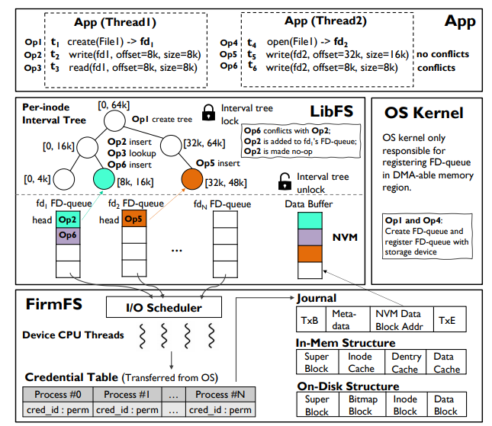
4. Design
CrossFS Design
= LibFS + OS Kernel + FirmFS
A Cross-layered direct-access file system
For achieving high performance direct-I/O, disaggregate file system(user, kernel, Firmware) to exploit host and device-level computing capabilities
Notes:
5가지 특징이자 디자인 원칙에 대해서 설명드리겠습니다.
먼저 CrossFS는 User-OS-Firmware상에 모두 존재하는 FS입니다.
LibFS, OS, FirmFS부분으로 나누어서, HostCPU, DeviceCPU를 서로 Utilize하기 위함이고,

Slide 11
4. Design
CrossFS Design
= LibFS + OS Kernel + FirmFS
A Cross-layered direct-access file system
OS-bypass for data-plane and control-plane operations
POSIX I/O call → LibFS → FirmFS I/O commands
Notes:
2번째로는, OS bypass, 데이터와 Control operations들 모두를 OS를 거의 거치지 않고 LibFS에서 NVM을 통해 곧바로 FirmFS에서 처리하게 되어
발생하게되는 시스템 콜 및 Trap overhead를 없앤다는 디자인 입니다.

Slide 12
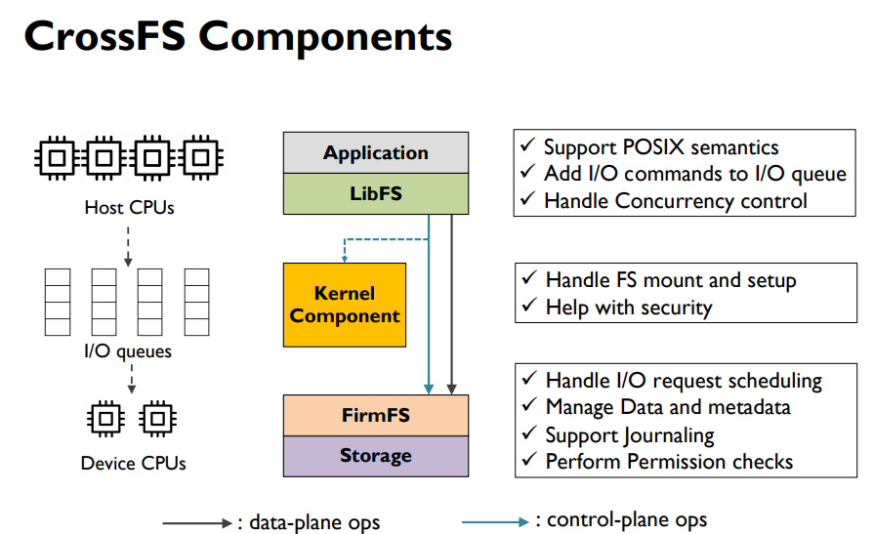
4. Design
OS-bypass for data-plane and control-plane operations
A Cross-layered direct-access file system
Notes:
좀 더 구체적으로는,
LibFS는 POSIX콜들을 FirmFS comman로 변환해주는 역할을 하게 됩니다.
FirmFS레벨에서는 받아온 Command들을 수행하게되고,
Storage에서 제공하는 I/Oqueue들을 통해서 수행하게 됩니다.

Slide 13
4. Design
CrossFS Design
= LibFS + OS Kernel + FirmFS
A Cross-layered direct-access file system
File descriptor-based fine-grained concurrency control
Notes:
세번째는,
CrossFS가 Filedescriptor레벨에서 lock을 잡는다는 내용입니다.
저자가 말하길, File descriptor자체가 이미 Application 레벨에서 제공되는 추상화 이기도 하고,
이미 같은 파일의 같은 블록에 대해 접근하려고 할 때, Application레벨에서 FD에 자동적으로 의존해여서 락을 잡는것을 발견해 이렇게 디자인 했다고 합니다.(Level DB, MYSQL, RocksDB)

Slide 14
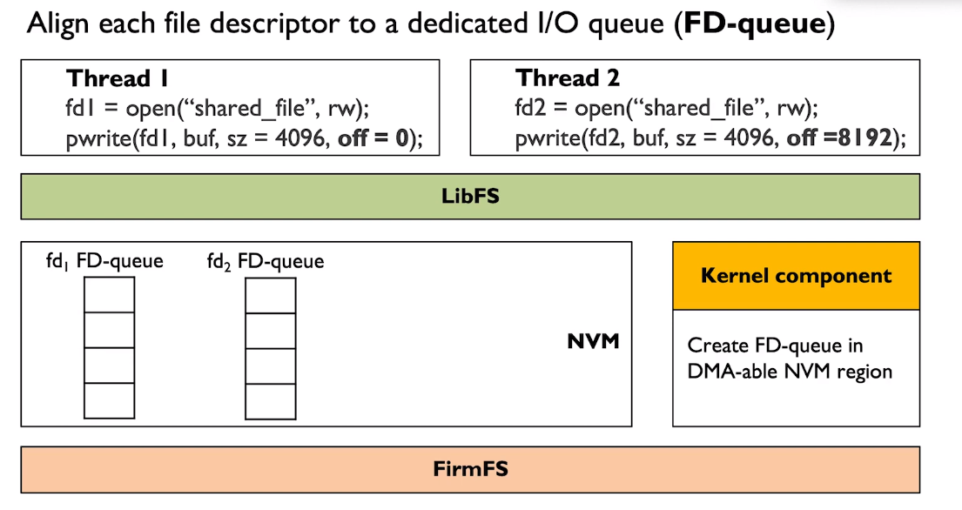


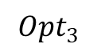

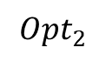

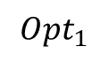
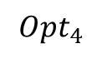
4. Design
File descriptor-based fine-grained concurrency control
File descriptor : A fundamental unit of synchronization (→ FD-queue)
$$Opt_{1}$$
$$Opt_{3}$$
$$Opt_{2}$$
$$Opt_{4}$$
$$head$$
1
$$head$$
2
Notes:
그래서 파일 디스크립터를 가지고 파일의 한 블록으로 추상화 해서, 이것을 그대로 I/O request queue에 넣겠다는 겁니다.
이렇게 만든 queue가 이제 Cross FS에서 말하는 FD-queue가 됩니다.
이 FD-queue는 같은 블록에 대한 IO에 대해서는 같은 큐에 fd가 들어가게 되고,
다른 블록에 대한 IO의 경우에 다른 큐에 fd가 들어가게 됩니다.

Slide 15
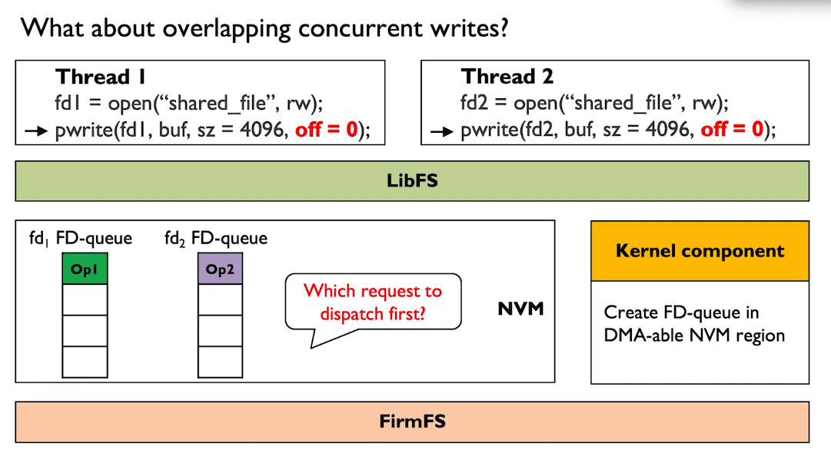

4. Design
File descriptor-based fine-grained concurrency control
Then, what is going on at
Overlapping block?
Notes:
그런데 이제 한가지 궁금점이
그렇게 되면, overlapping block에 대해서,

Slide 16
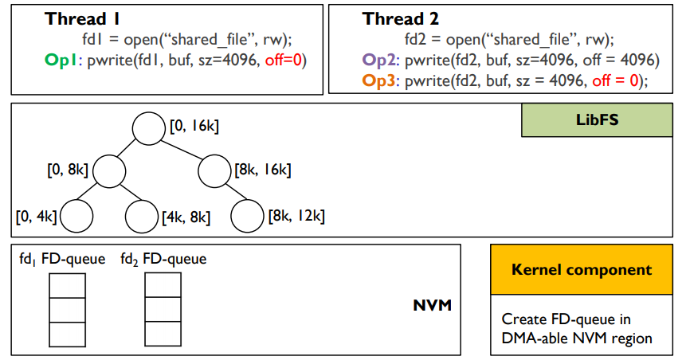


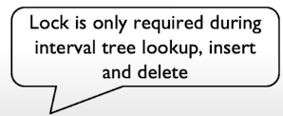
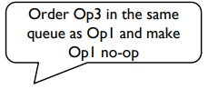
4. Design
File descriptor-based fine-grained concurrency control
Interval tree data structure : resolving overlapping writes with RB-tree
1
2
3
Notes:
DRAM과 PCM, NAND간의 속도차이가 몇배가 나는지 설명

Slide 17
4. Design
CrossFS Design
= LibFS + OS Kernel + FirmFS
A Cross-layered direct-access file system
Firmware-level file descriptor’s I/O queue scheduling
Notes:
DRAM과 PCM, NAND간의 속도차이가 몇배가 나는지 설명

Slide 18
4. Design
Firmware-level file descriptor’s I/O queue scheduling
I/O Scheduling Policies
Round Robin
(Pros) Provides fairness , (Cons) Delays blocking operations(fsync)
Urgent Aware Scheduling
→ Prioritize blocking requests
Avoids write request starvation
More sophisticated policies → Future Work!
Notes:
DRAM과 PCM, NAND간의 속도차이가 몇배가 나는지 설명

Slide 19
4. Design
CrossFS Design
= LibFS + OS Kernel + FirmFS
A Cross-layered direct-access file system
Cross-layered crash consistency → NVMs
Notes:
OS generates random 128-bit unique ID

Slide 20
4. Design
Cross-layered crash consistency → NVMs
FD-queue Crash Consistency
NVM provides persistence
CLWB and memory fence to provide crash consistency
(In the absence of NVM, CrossFS uses DRAM for FD-queues, providing the guarantees of traditional kernel FS)
Low-overhead FirmFS Crash Consistency
Data journaling is expensive
However, CrossFS, I/O request and data are buffered in FD-queue buffer
In journal entry, there is an offset of data buffer in NVM
Meaning of “Low-overhead” , “lightweight journaling” :
Get data journaling benefits at the cost of metadata journaling
Notes:
DRAM과 PCM, NAND간의 속도차이가 몇배가 나는지 설명

Slide 21

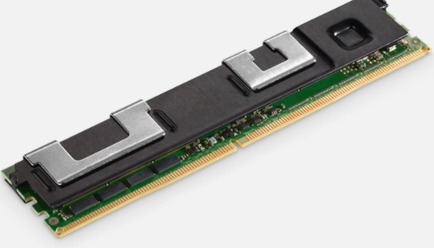
5. Evaluation
CrossFS: Evaluation Metric
How effective is CrossFS in exploiting the cross-layered design and FD-based concurrency?
Can CrossFS’ cross-layered design scale for metadata intensive workloads with no data sharing across threads?
Does CrossFS benefit real-world applications?(RocksDB)
[Appendix]What is the impact of host configuration such as storage bandwidth, device-CPU frequency, and PCIe latency?
[Appendix] How effective is CrossFS’ FD-queue scheduler?
Experimental Setup
Host |  | 2.7GHz Intel(R) Xeon(R) Gold, dual-socket, 64-core with 32GB memory & 512 SSD
NVM |  | 512GB Intel Optane DC NVM (4x128GB)
State-of-the-art File Systems
KernelFS | Ext4-DAX | Kernel-level file system
 | NOVA | FAST ’16
UserFS | Strata | SOSP ’17
 | SplitFS | SOSP ’19
Firmware | DevFS | FAST ‘18
Notes:
DRAM과 PCM, NAND간의 속도차이가 몇배가 나는지 설명

Slide 22
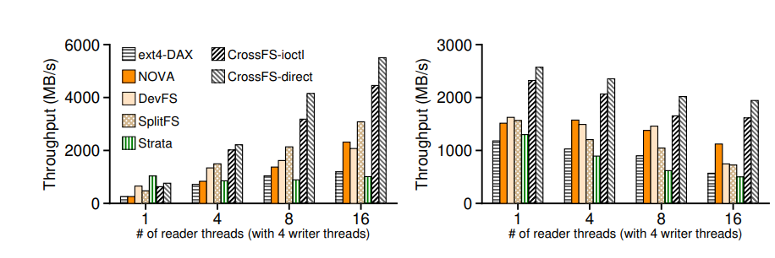
4. Design
How effective is CrossFS in exploiting the cross-layered design and FD-based concurrency?
Concurrent accesses scaling when sharing files
Microbenchmark
Read scalability
Write scalability
3.41x
☆Readers do not have to wait for writers
☆Non-overlapping writes dispatched in parrallel
Notes:
CrossFS-ioctl uses IOCTL commands bypassing VFS but with OS traps, whereas CrossFS-direct avoids OS traps and VFS

Slide 23
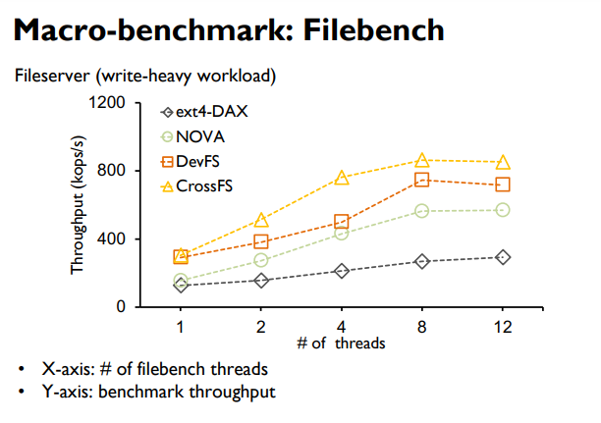
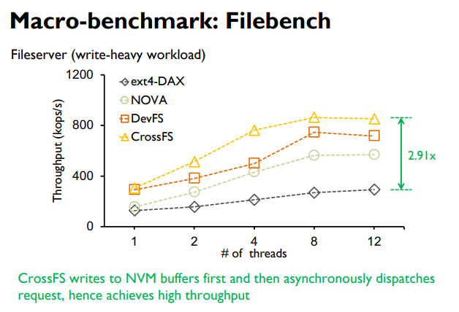
4. Design
Can CrossFS’ cross-layered design scale for metadata intensive workloads with no data sharing across threads?
*write-heavy : metadata-intensive workloads such as file create, delete, directory update
Notes:
DRAM과 PCM, NAND간의 속도차이가 몇배가 나는지 설명

Slide 24
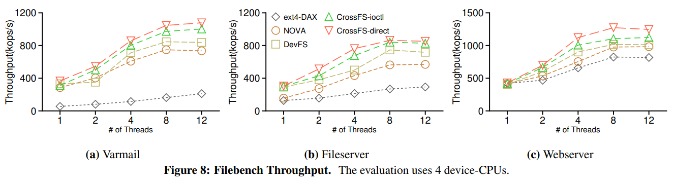
4. Design
Can CrossFS’ cross-layered design scale for metadata intensive workloads with no data sharing across threads?
*metadata-heavy
*write-heavy
*read-heavy
Notes:
CrossFS-ioctl uses IOCTL commands bypassing VFS but with OS traps, whereas CrossFS-direct avoids OS traps and VFS

Slide 25
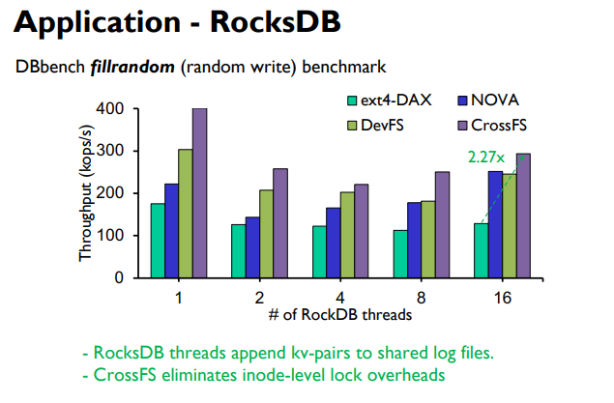
4. Design
Does CrossFS benefit real-world applications?(RocksDB)
Notes:
DRAM과 PCM, NAND간의 속도차이가 몇배가 나는지 설명

Slide 26
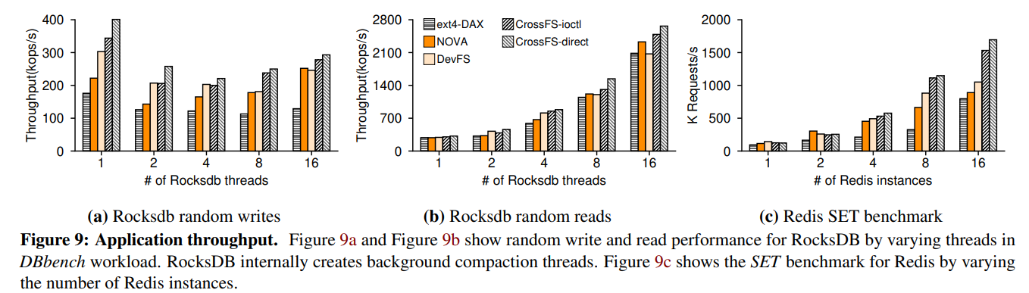
4. Design
Does CrossFS benefit real-world applications?(RocksDB)
Notes:
DRAM과 PCM, NAND간의 속도차이가 몇배가 나는지 설명

Slide 27
6. Conclusion
CrossFS
Storage hardware (with compute capability) has reached the microsecond era
Providing direct I/O and utilizing host and storage-level compute is critical
CrossFS approach : Cross-layered storage file system design
Fine grained concurrency control is important for I/O scalability
CrossFS approach : File-descriptor concurrency control
(Future Work) : H/W integration, support sophisticated scheduling policies, other FS operations(e.g. mmap())

Slide 28
CrossFS: A Cross-layered Direct-Access File System
Yujie Ren, Changwoo Min, Sudarsun Kannan
In 2020 USENIX Symposium on Operating Systems Design and Implementation
Thank You!
2021. 02. 02
Presentation by Inho, Song
inhoinno@dankook.ac.kr
Notes:
Let me begin my presentation.
Today I will give a presentation on “Fully Automatic Stream Management for Multi-Streamed SSDs Using Program Contexts”

Slide 29
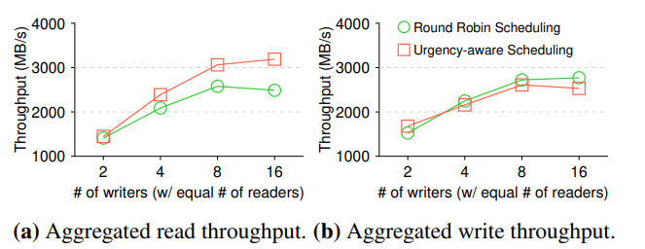
Appendix. 5. Evaluation
How effective is CrossFS’ FD-queue scheduler?
Notes:
DRAM과 PCM, NAND간의 속도차이가 몇배가 나는지 설명

Slide 30
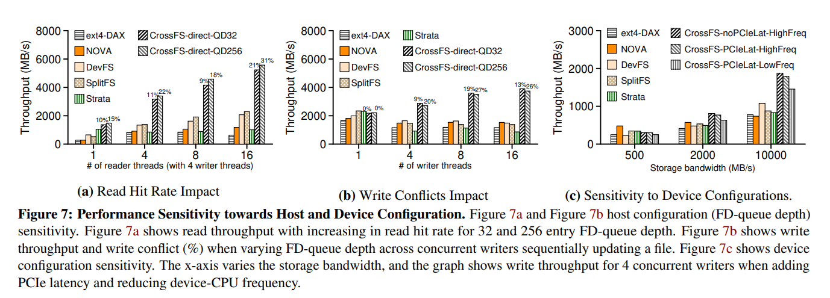
Appendix. 5. Evaluation
What is the impact of host configuration such as storage bandwidth, device-CPU frequency, and PCIe latency?
Notes:
DRAM과 PCM, NAND간의 속도차이가 몇배가 나는지 설명

Slide 31
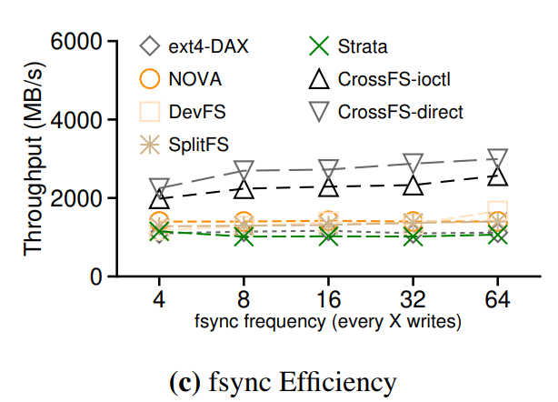
Appendix. 5. Evaluation
Although CrossFS adds a commit barrier to all FD-queues of an inode, device-CPUs can concurrently dispatch requests across FD-queues without synchronizing until the barrier completion.
Additionally, CrossFS avoids system call cost for both fsync and write operations

Slide 32
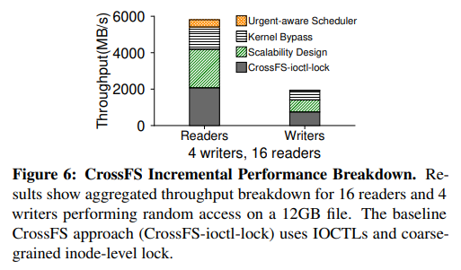
Appendix. 5. Evaluation
Scalability design : coarse-grain inode rw-lock → inode-level lock with fine grain FD-queue
Kernel Bypass : VFS → No VFS

